Slide 1
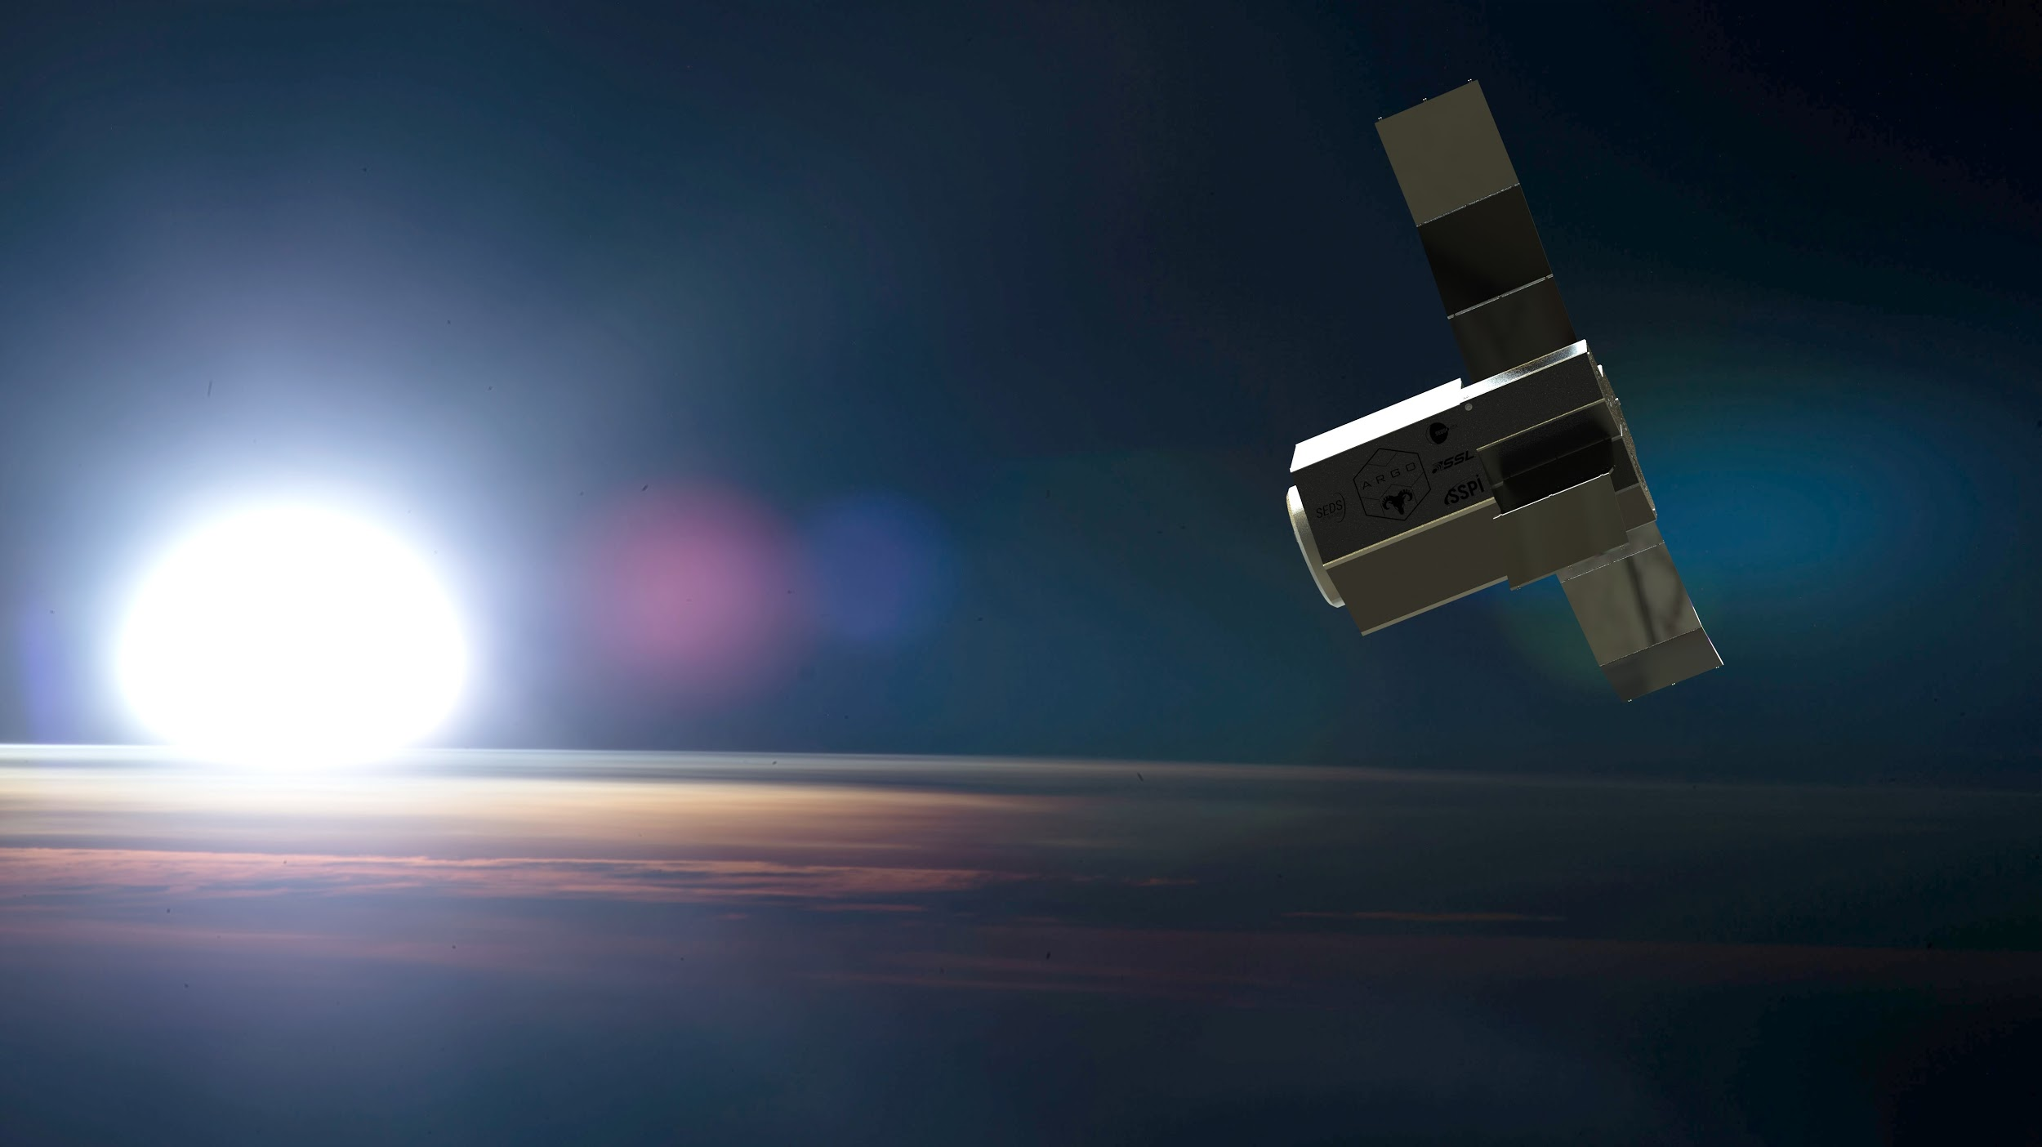





Slide 2

Design Purpose
Space-tug for multiple trips between LEO, GEO and LLO carrying 34 metric tons of cargo
Throttable propulsion with long lifespan and efficient fuel consumption
Ideal lifespan of 30 clients for 7 years of continuous operation
Modular assembly for repairs to extend life, and easy disposal of at-risk components through heliocentric graveyard orbit

Slide 3

Cost Analysis
ISS Resupply | SpaceX | Orbital ATK
Contract Cost | $70M | $100-125M
Actual Cost | $30.6-40M | $75-100M
Mass per Payload | 2MT | 2MT
 | GEO via Falcon 9 | GEO via Argo x Falcon 9 | LLO via SLS | LLO vis Argo x Falcon 9
Cost per Kilogram | $7,470 | $4,000 | $0.5-1M | $6,500

Slide 4
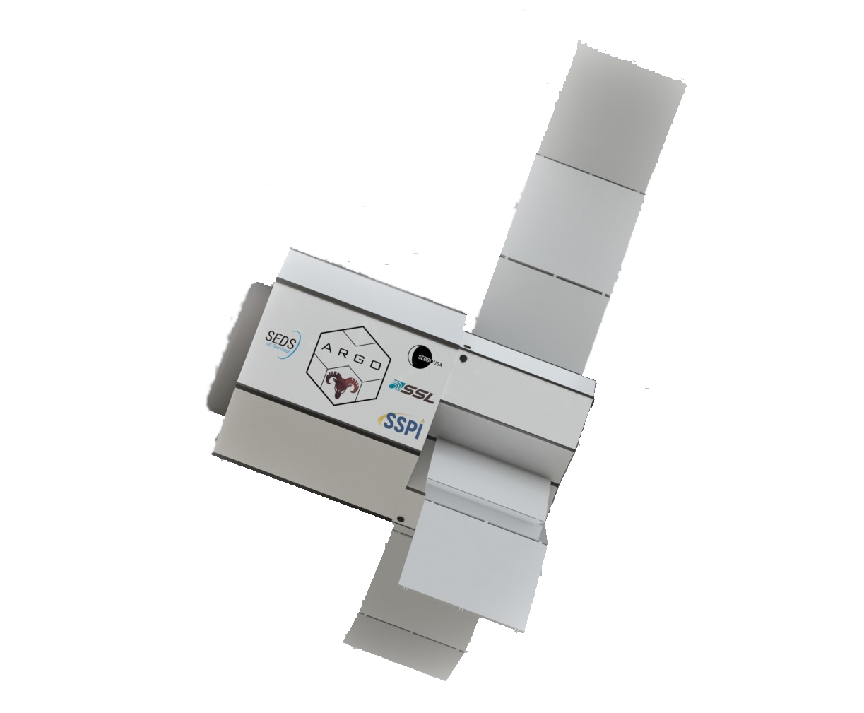
Structures/Propellant Feed
Main structure is designed around the main tank. Comprised of aluminum and Titanium
COPV tank. Possible multiple tanks to maximize space efficiency
Radiators leak off excess heat
Propellant Feed system designed as an upscaled Xenon Feed currently featured on satellite
Flow control for throttle control; more power for more time critical missions
System needs to be refuelable
Provides propellant to ACS thrusters for both Attitude control and emergency venting

Slide 5

Engines
Power Limited & Thrust Demanding
Three X3 Hall Effect Thrusters
100 kW each
5.4 N each
University of Michigan Plasmadynamics & Electric Propulsion Laboratory
Three Channel Design
Throttling
Lifespan (10,000 hr)
Channel Wall Erosion / Degradation
Magnetic Shielding Research

Slide 6
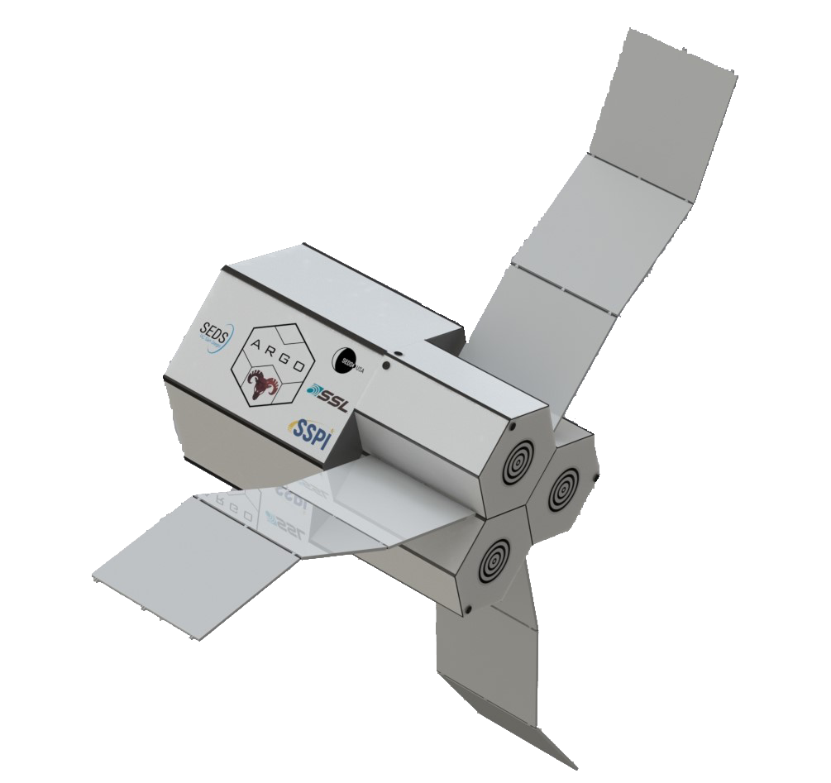
Power Systems
SAFE-400 reactor with a Brayton Power system
Brayton offers 100 kW electrical power with 300 kW waste - current design limitation
Advancements in efficient power conversion required for feasible design

Slide 7
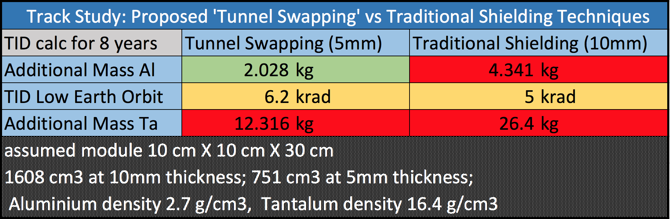
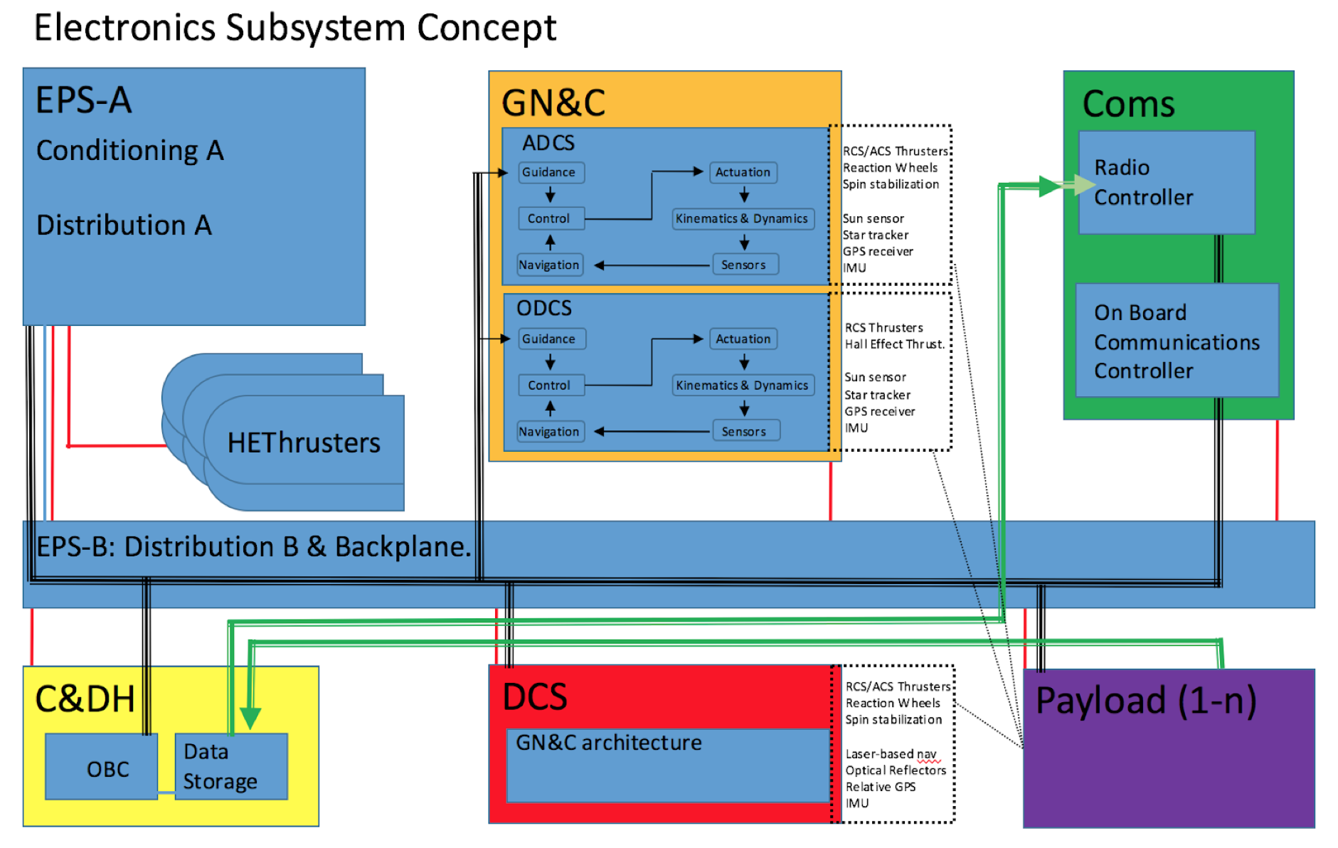
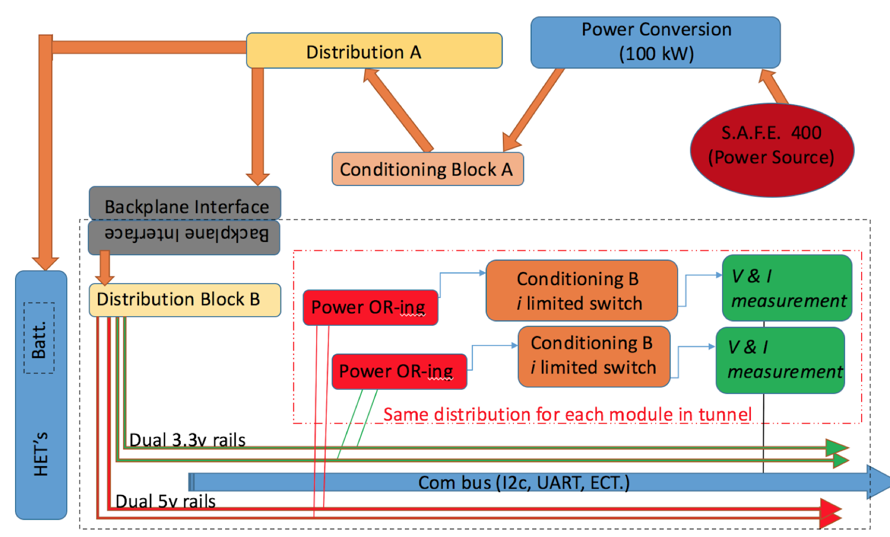
Electrical Systems
Notes:
Modular Design Reduces dry-mass DT Radiation Shielding by enabling replacement
Modular Design-- Cross-strapping, majority-rule voting, dual-triple redundant
Leverage servicing ops to bolster EE system robustness
Replace SS near total-ionization dose, or after single-event upsets (latch-up/power cycle etc).

Slide 8

Results
34 MT to LLO in 45-90 (one way) days depending on mass and orbital positioning
34 MT to GEO in 7-14 (one way) days
Reliable operation for 7 years with potentially 30 clients depending on mission parameters
Retrofitting capabilities for future potential mission capabilities

Slide 9
Questions?

